Slide 1

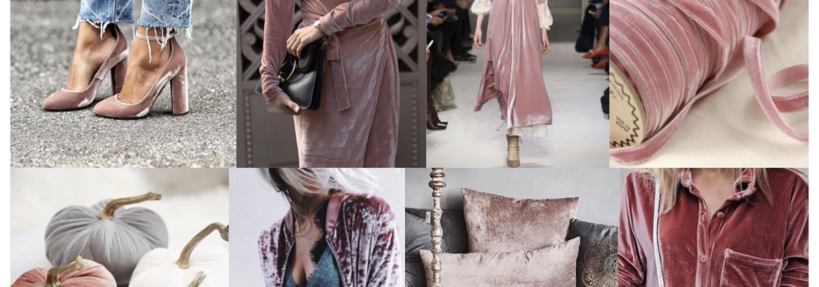

VELVET Crush F/W ‘17
By: MERCEDES GONZALEZ

Slide 2
History of velvet
Velvet: A soft fabric having a smooth, dense pile and a plain underside. Velvet fabric catches light in a unique way.
Velvet originated from eastern culture. Pieces of velvet were found in china dating back to old dynasties. Iraq & Egypt were also among the first to produce velvet
At first Velvet was an extremely high end good which was only available to the wealthy.
From 1400-1600 (The Renaissance) Velvet was very popular.
During the industrial Revolution, velvet was produced easier and faster which allowed for the product to be available to all classes.
Velvet was a go to fabric in the 80’s & 90’s.
Velvet is now a major trend in the F/W ‘17 season
Notes:
Velvet is one of the biggest trends during this fall and winter season. Velvet garments walked down multiple designer runways this season. A few designers that included velvet in their collections are Cinq A Sept, Tibi, Gucci, Self Portrait, & Prada. This trend is important to keep an eye on because I believe it will be a returning trend next season. It’s also a trend that women of all classes can buy into. There are designer velvet options as well as affordable priced options.

Slide 3
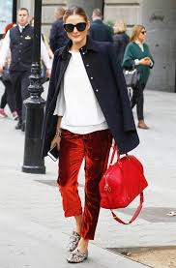
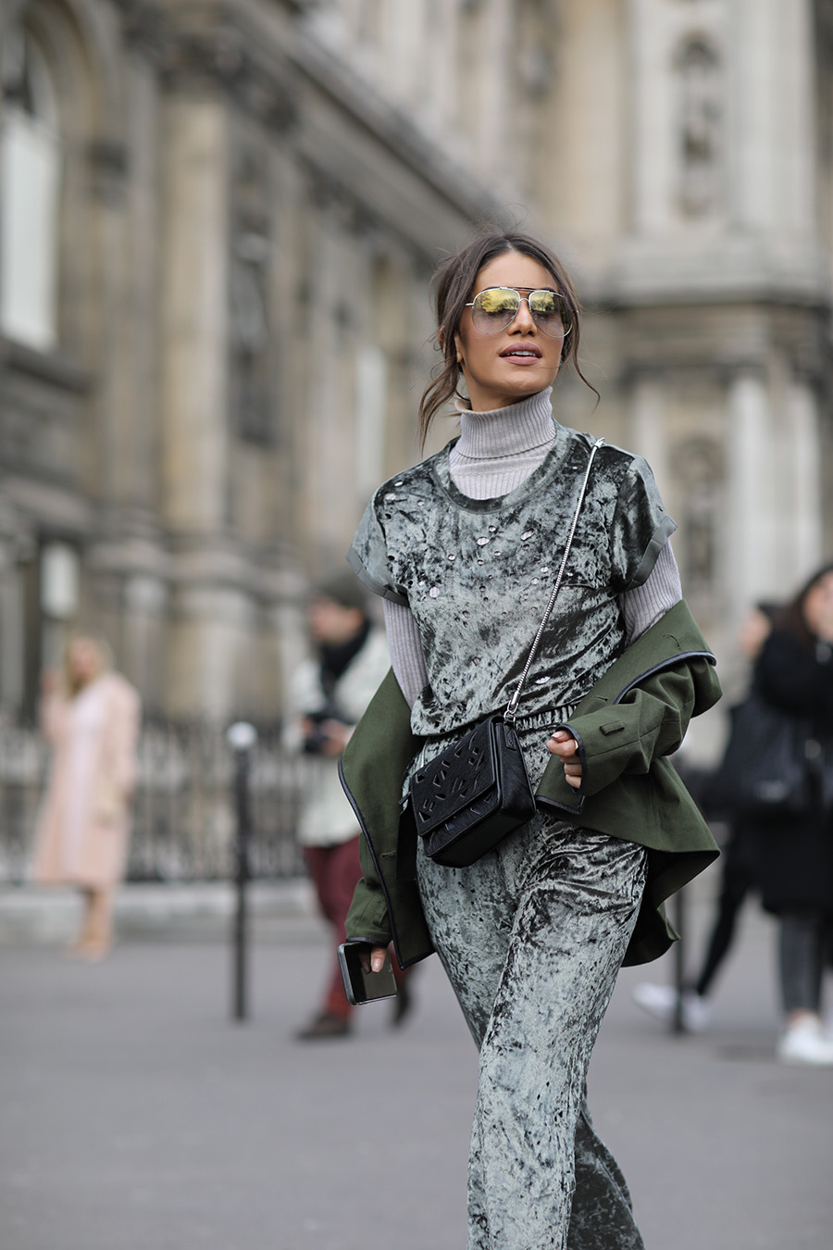
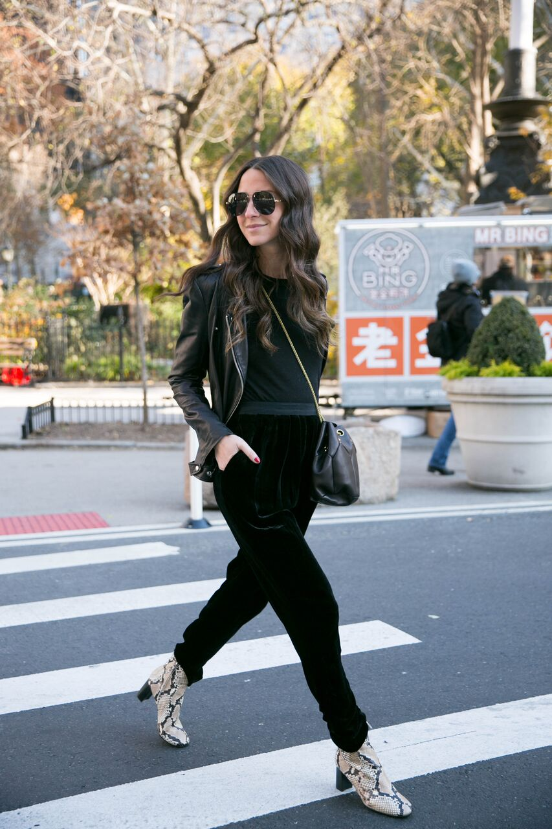
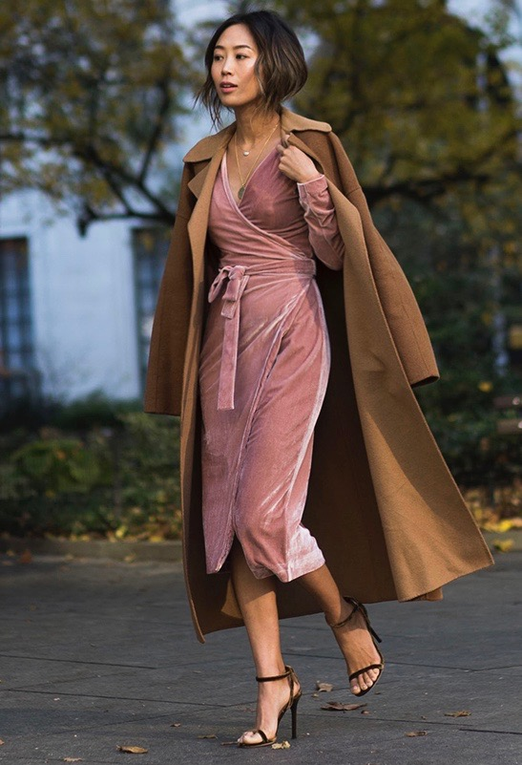
STREET STYLE STARS: VELVET EDITION
Olivia Palermo
Camila Coelho
Something Navy
Song Of Style

Slide 4
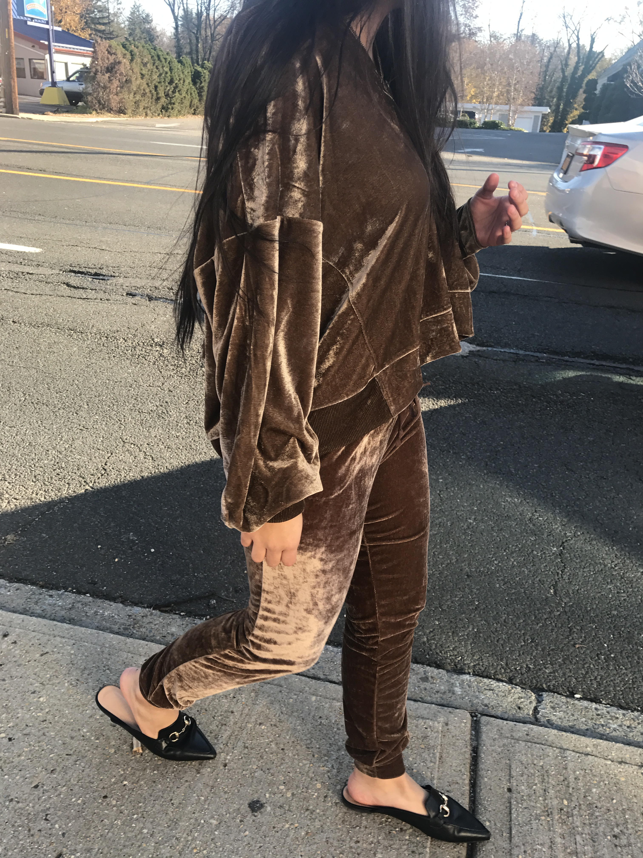
VELVET Set
F/W ’17 Street Style

Slide 5
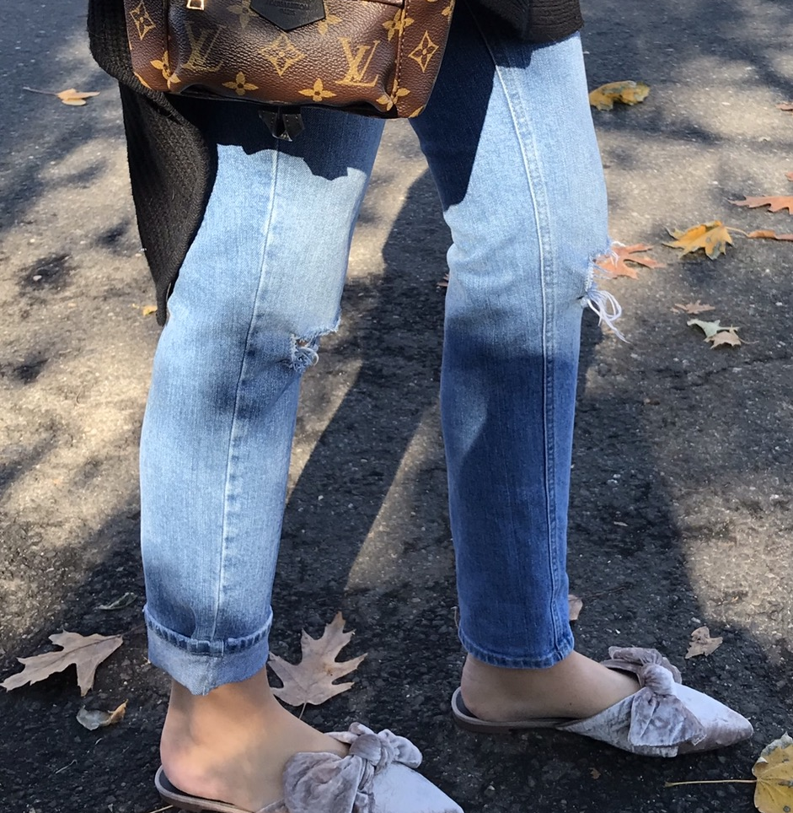
VELVET Shoes
F/W ’17 Street Style

Slide 6

VELVET BLOUSE
F/W ’17 Street Style

Slide 7
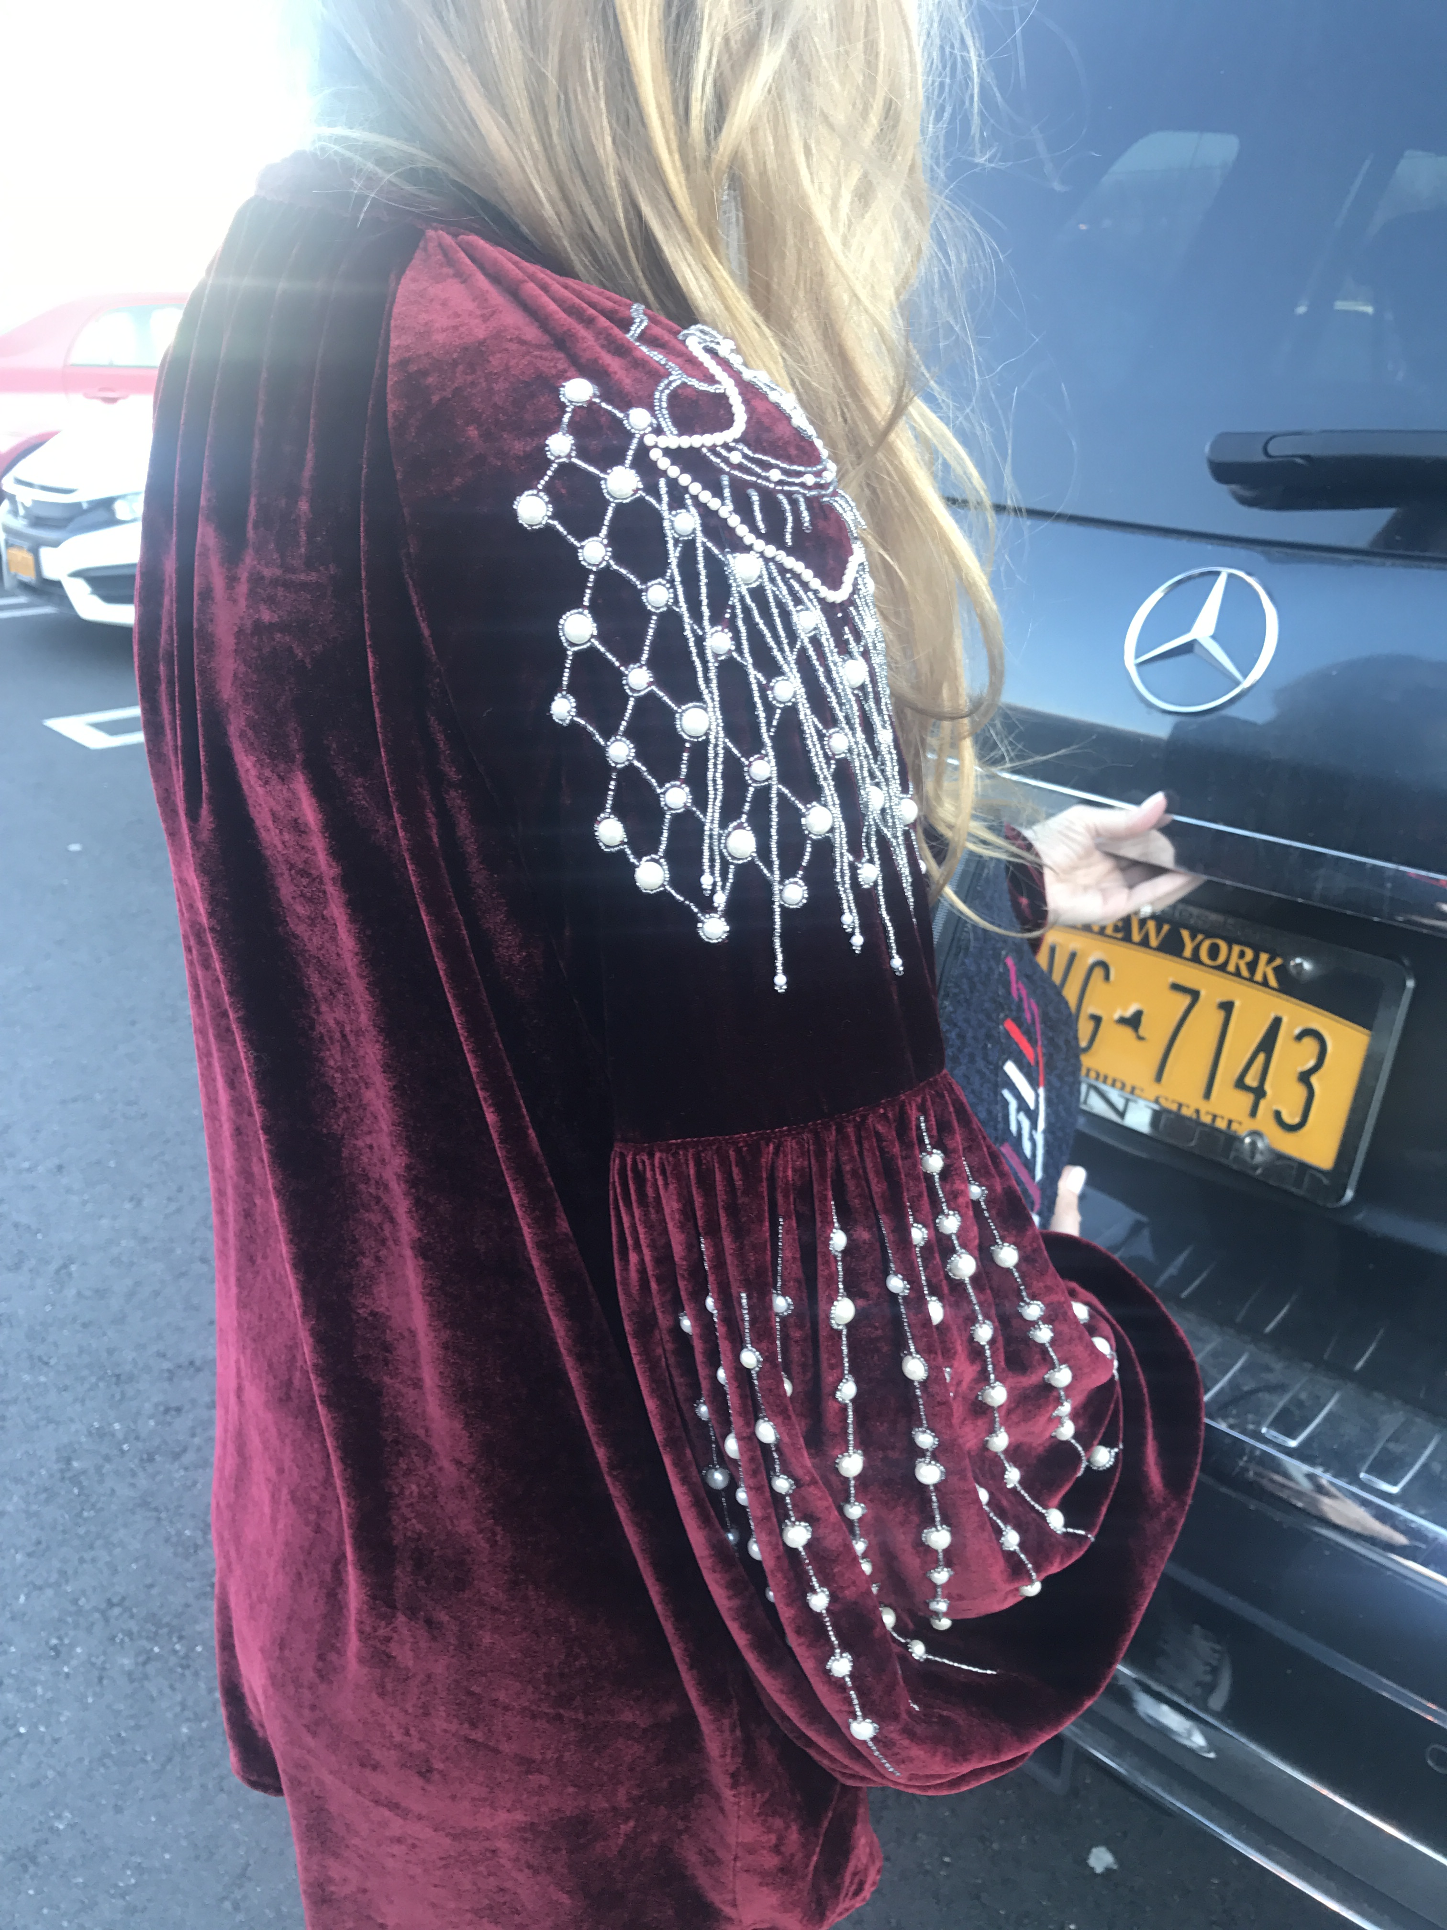
VELVET Tunic
F/W ’17 Street Style

Slide 8
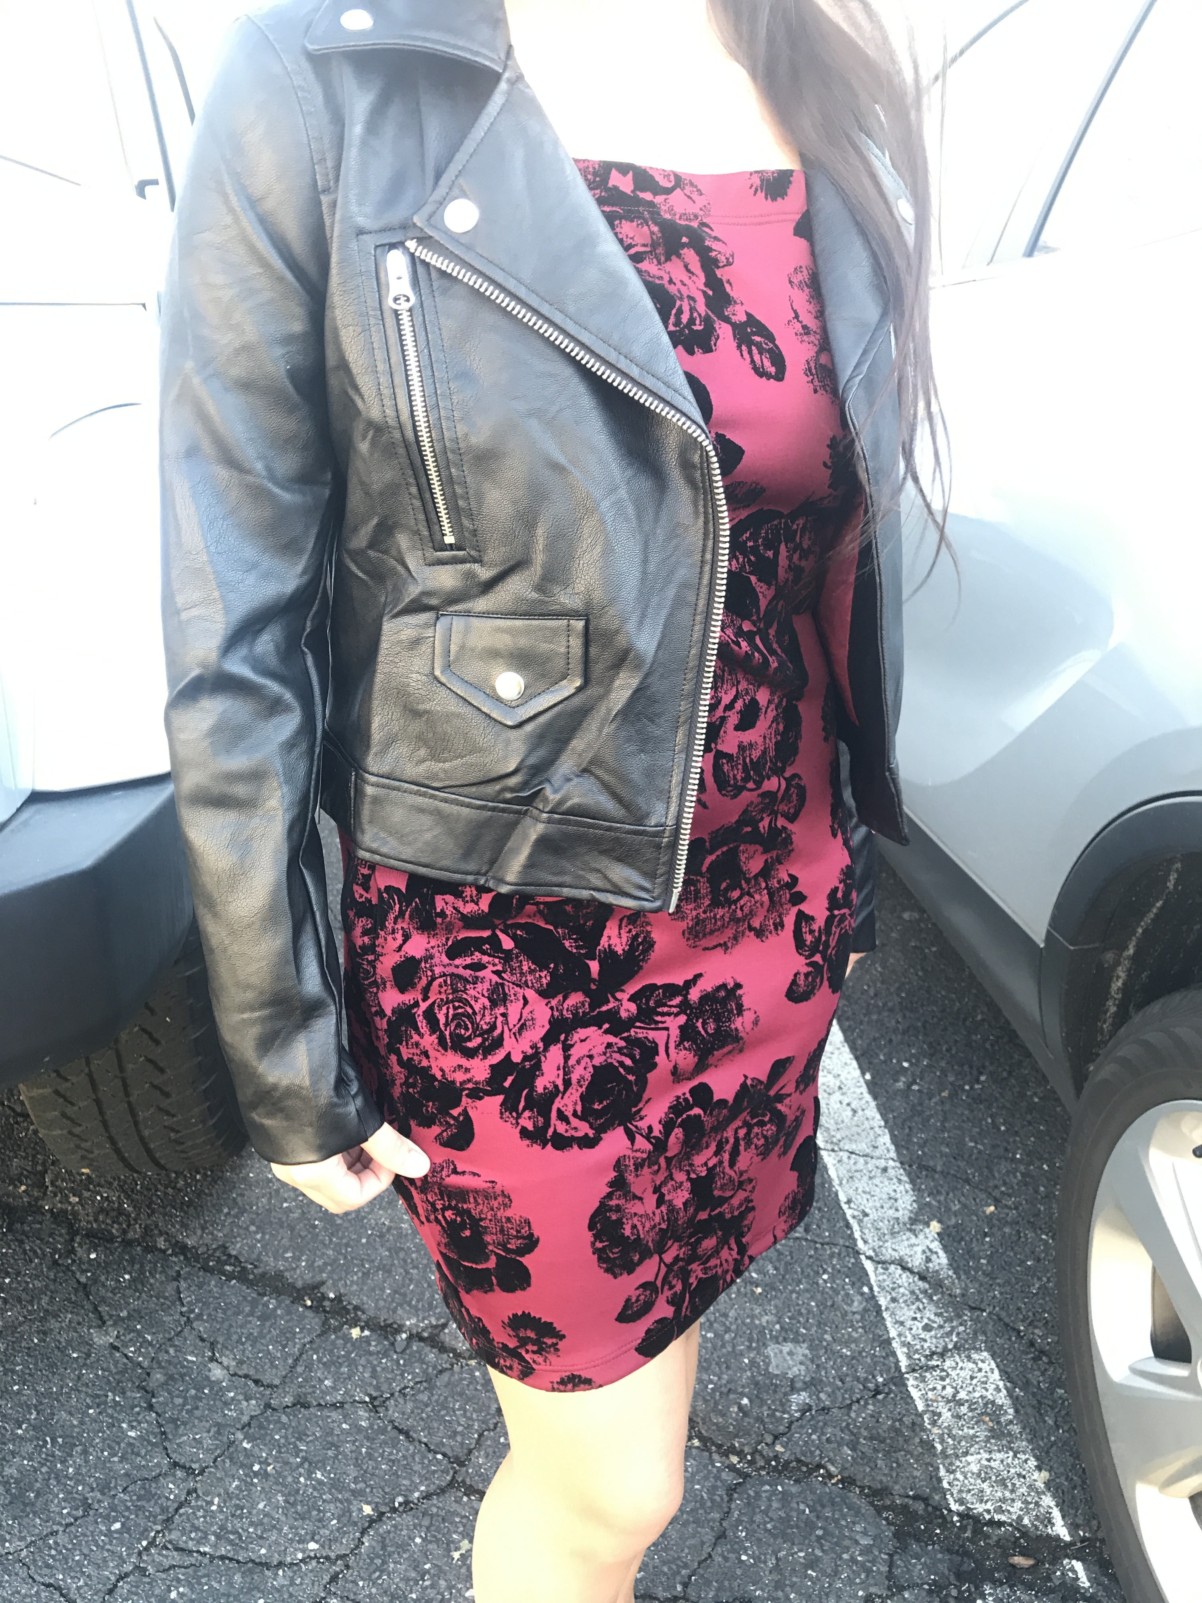
VELVET FLoral Print
F/W ’17 Street Style

Slide 9
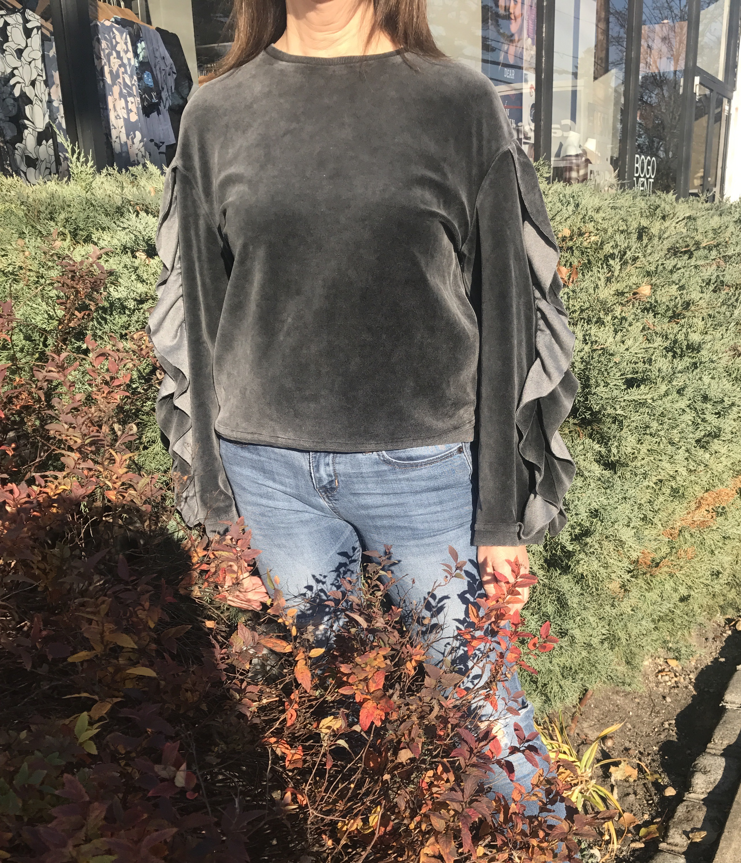
VELVET TOP
F/W ’17 Street Style

Slide 10
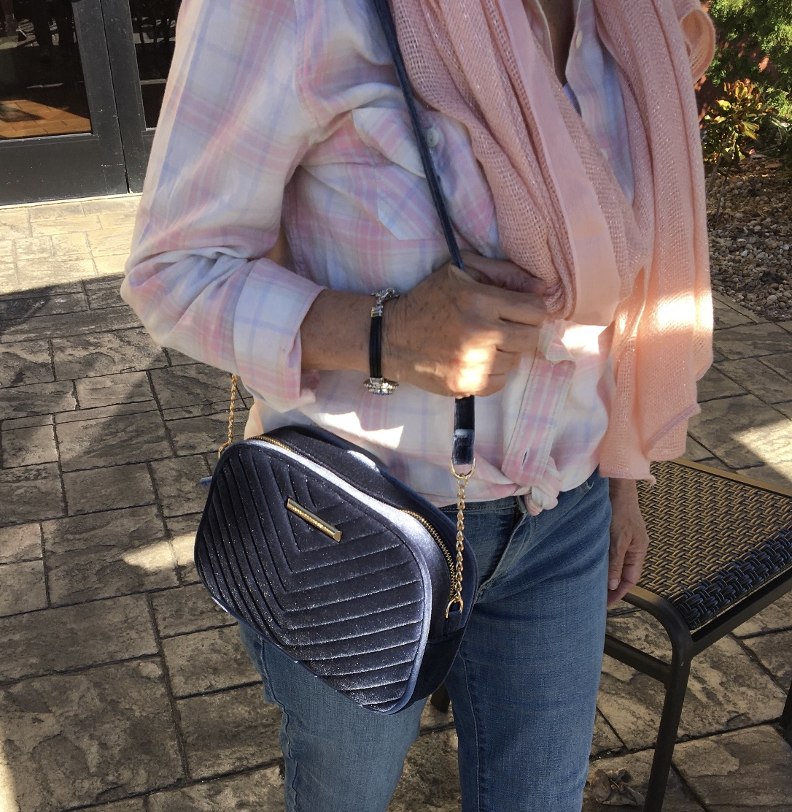
VELVET BAG
F/W ’17 Street Style

Slide 11
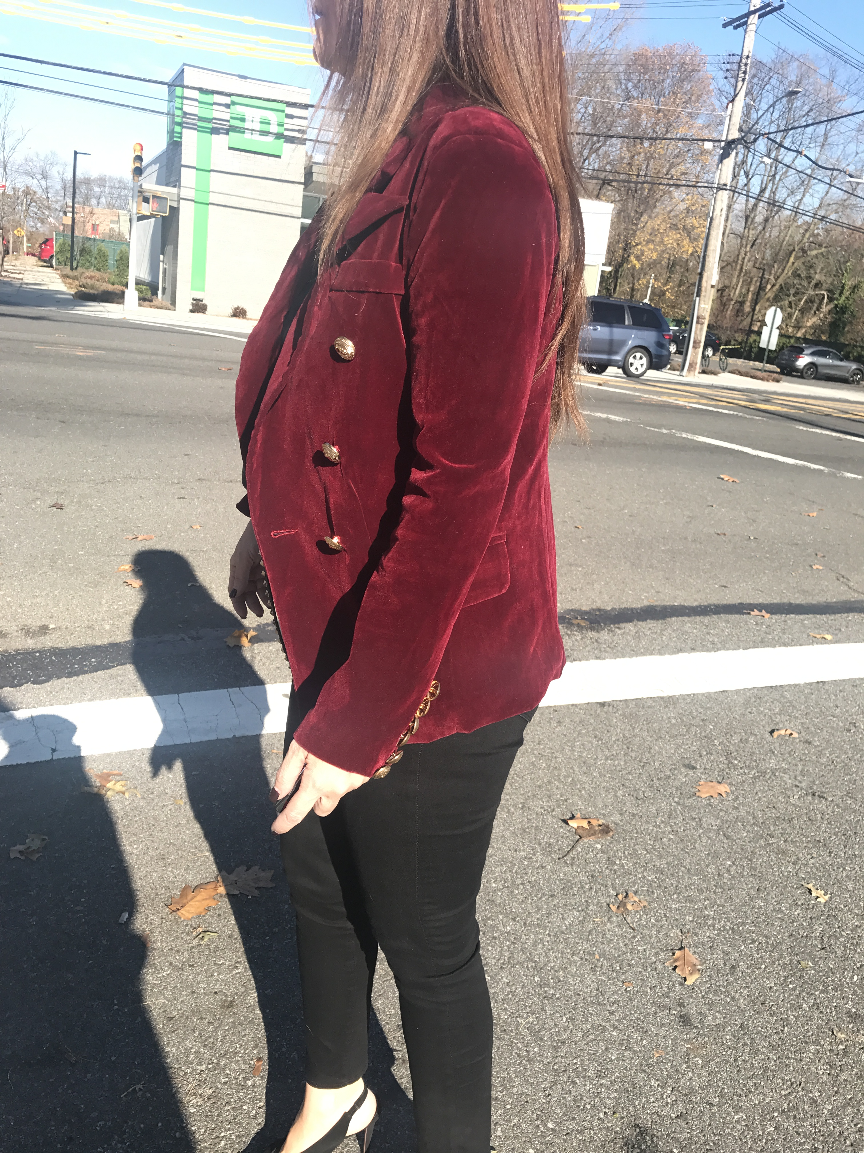
VELVET bLAzer
F/W ’17 Street Style

Slide 12
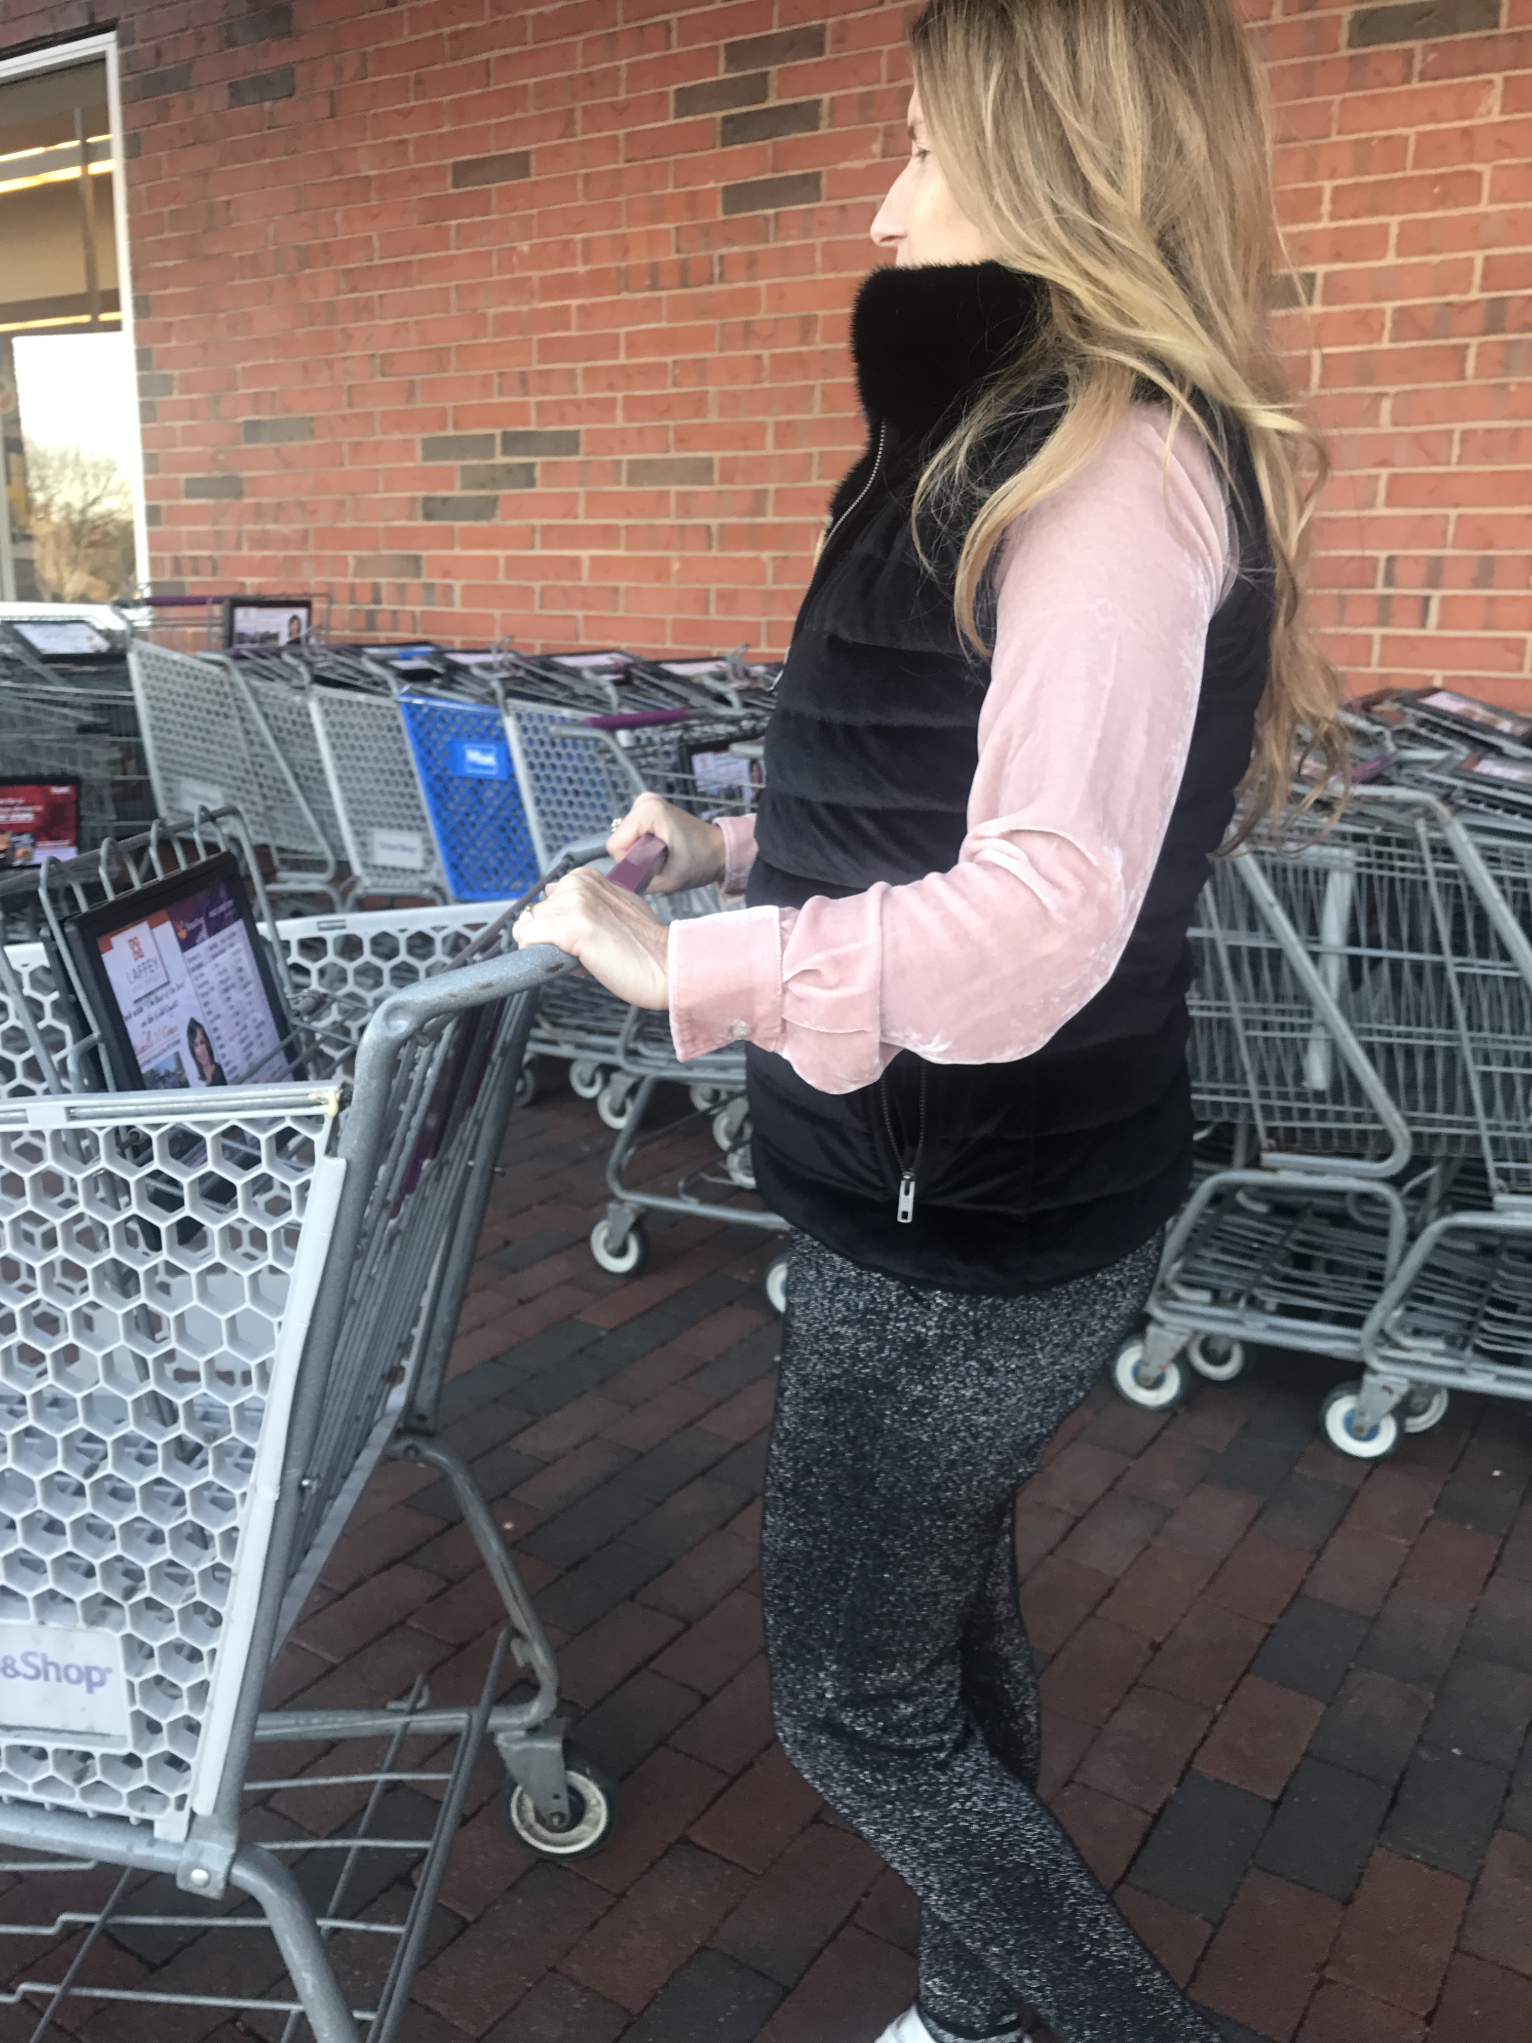
VELVET Vest & Blouse
F/W ’17 Street Style

Slide 13
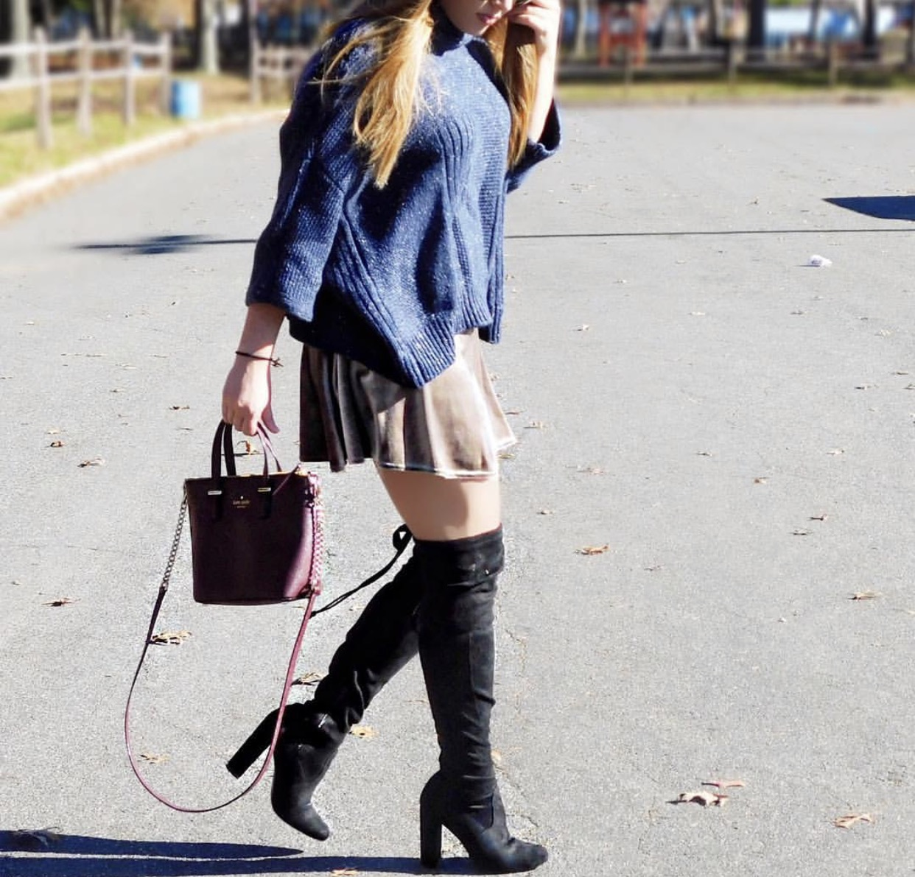
Velvet Skater Skirt
F/W ’17 Street Style

Slide 14
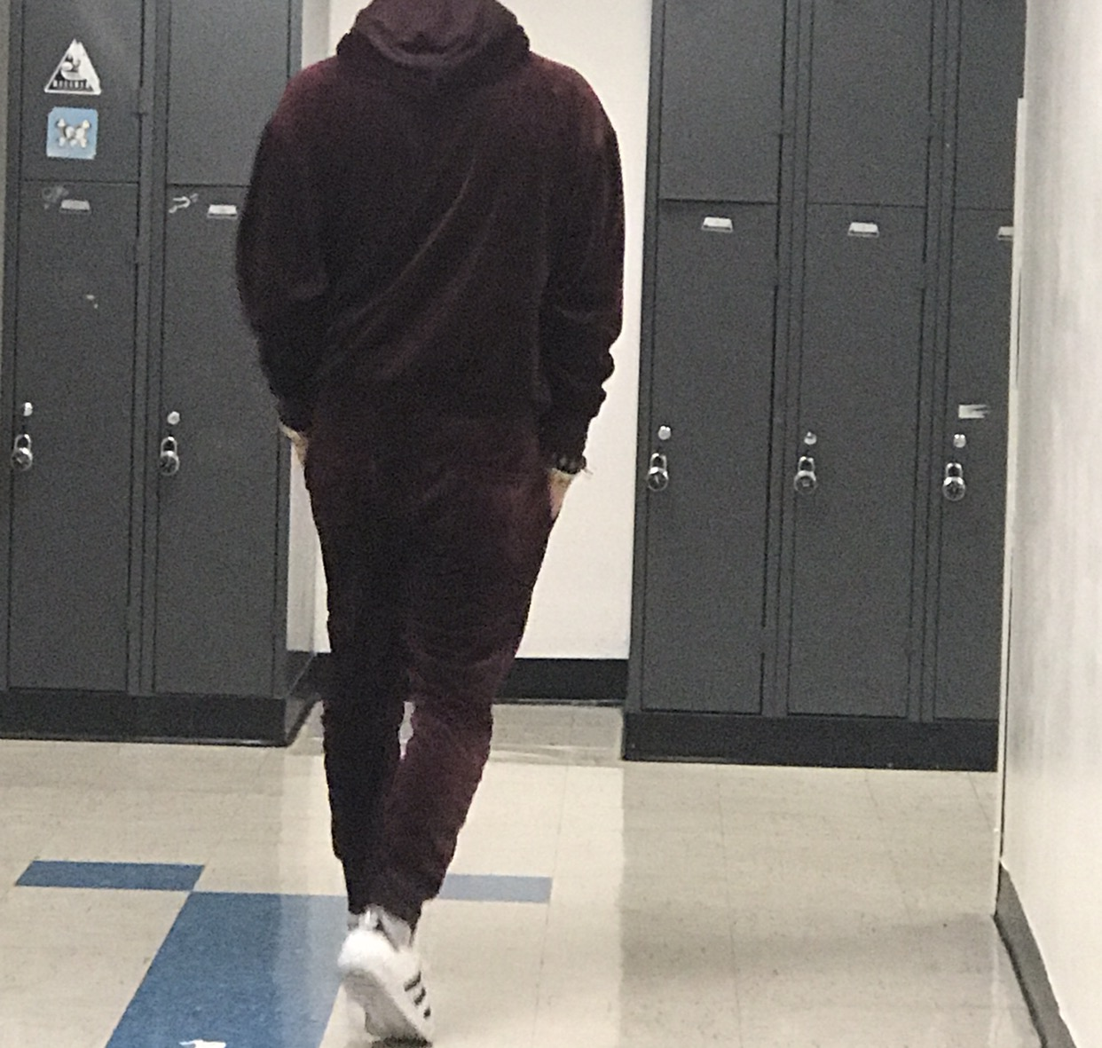
Velvet Sweatsuit
F/W ’17 Street Style

Slide 15
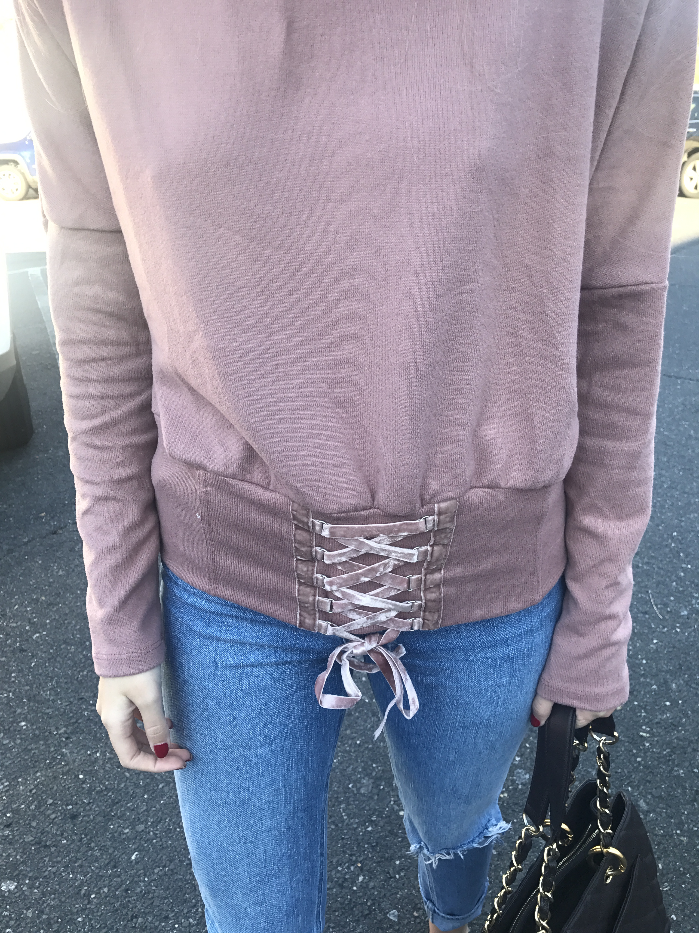
VELVET Lace up
F/W ’17 Street Style

Slide 16
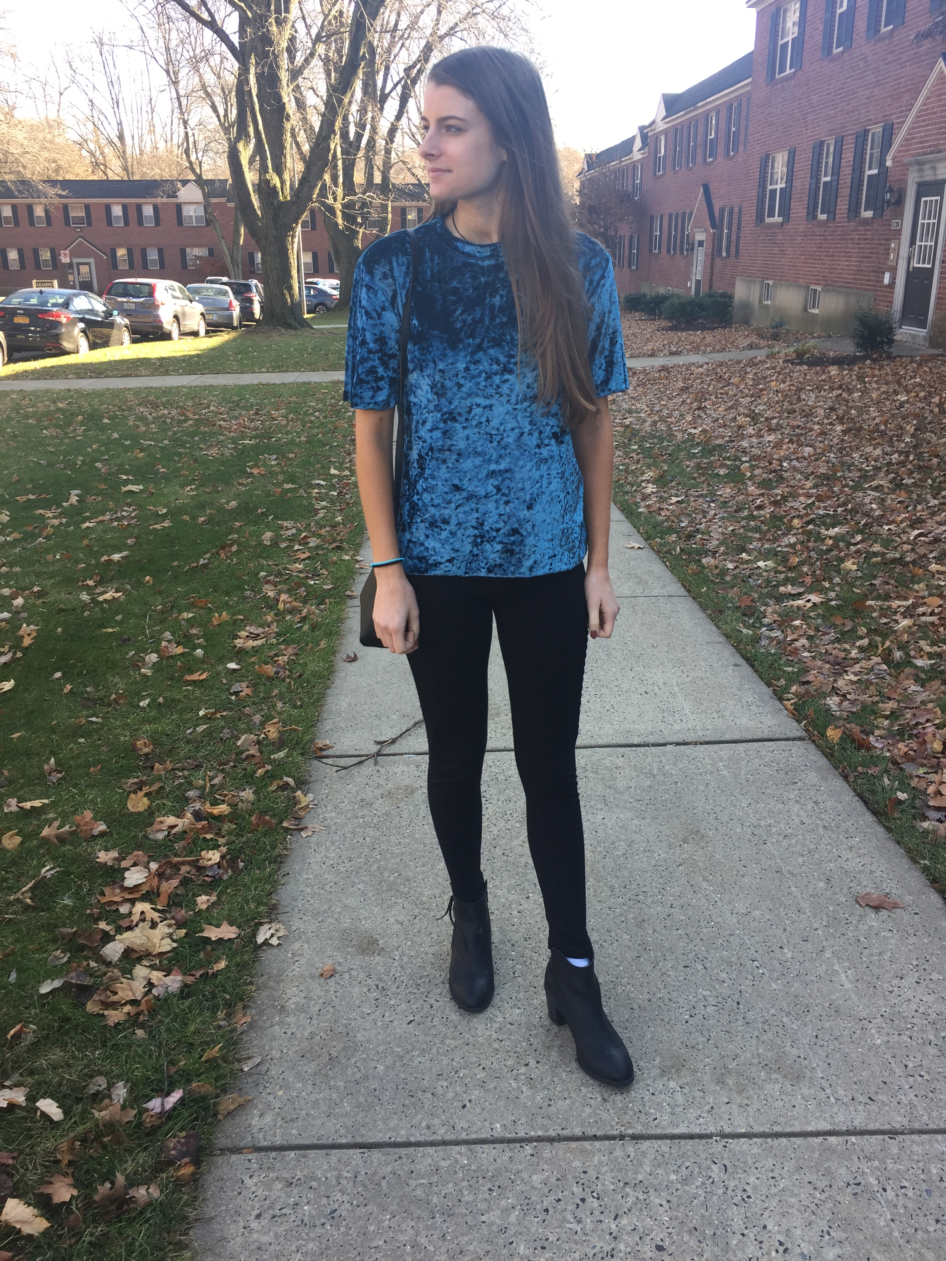
VELVET TEE
F/W ’17 Street Style

Slide 17
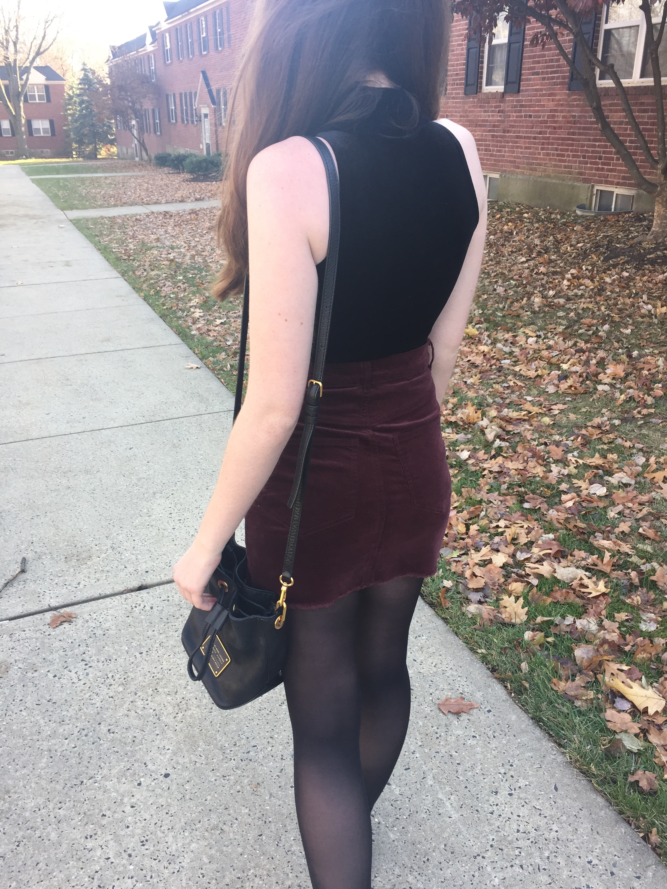
VELVET SKIRT F/W ’17 Street Style

Slide 18
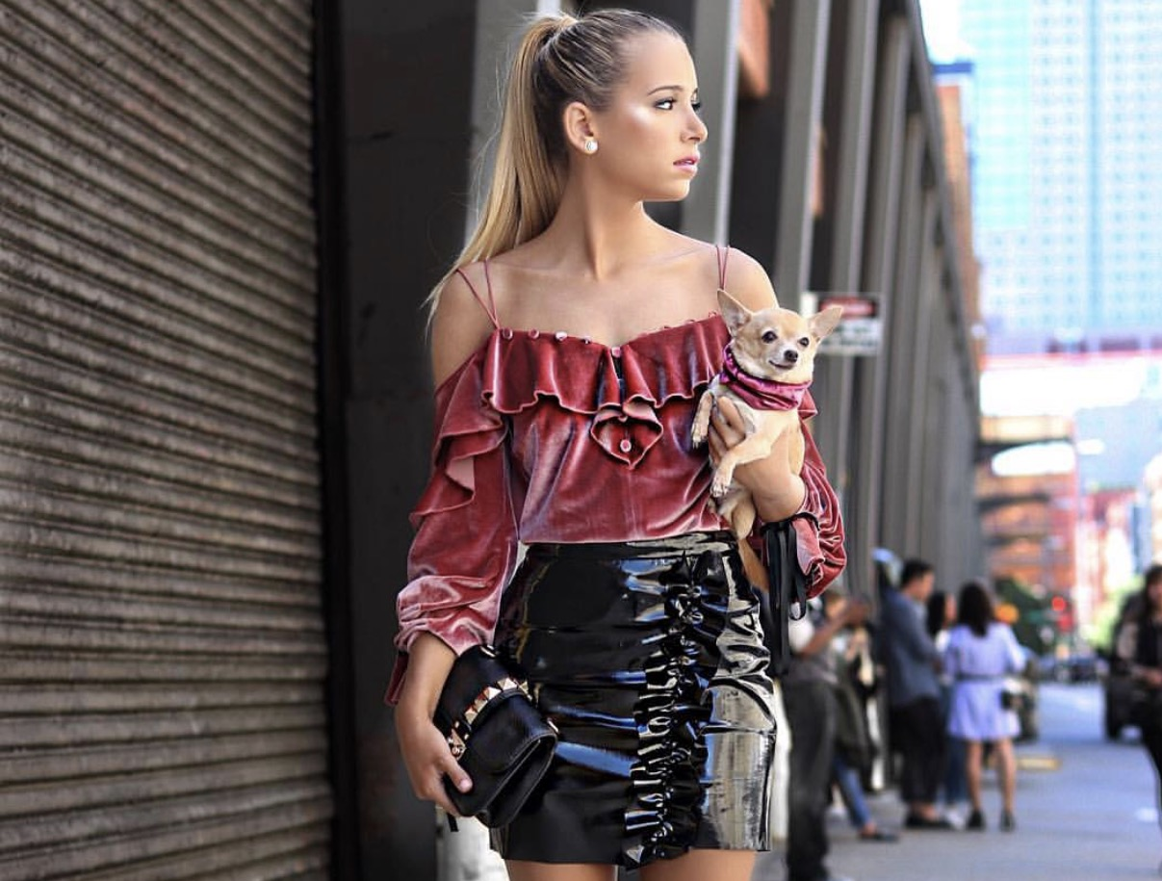
VELVET BLOUSE
F/W ’17 Street Style

Slide 19
THANK YOU!!!

Slide 20
bibliography
Pinterest.com
https://startupfashion.com/fashion-archives-look-history-velvet/

